Slide 1

portfolio

Slide 2

welcome!
Presented by
Ahmed Taher Abdelrhman Ahmed
Joy Yousef Saif Abd-Elaziz
Minna Nader Ahmed Mahmoud
Let’s begin!

Slide 3


ROLES OF THE TEAM
1
Ahmed taher: footer, contact me, nav bar
2
minna nader: projects
3
saif abd-elaziz: about me
4
joy yousef: compiled the code.
5
Ahmed mahmoud: home page
6
abdelrhman ahmed: powerpoint

Slide 4
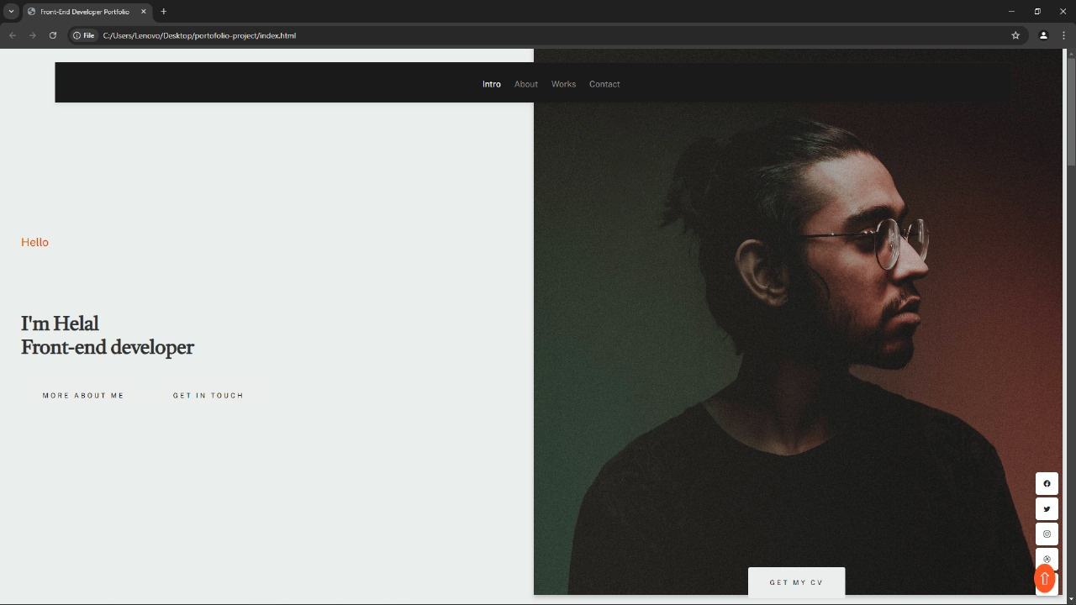
homepage

Slide 5
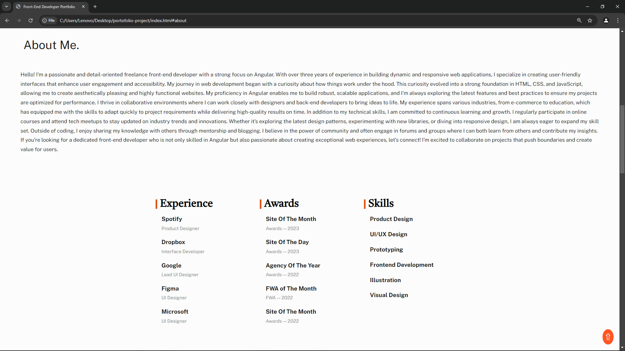
about me

Slide 6
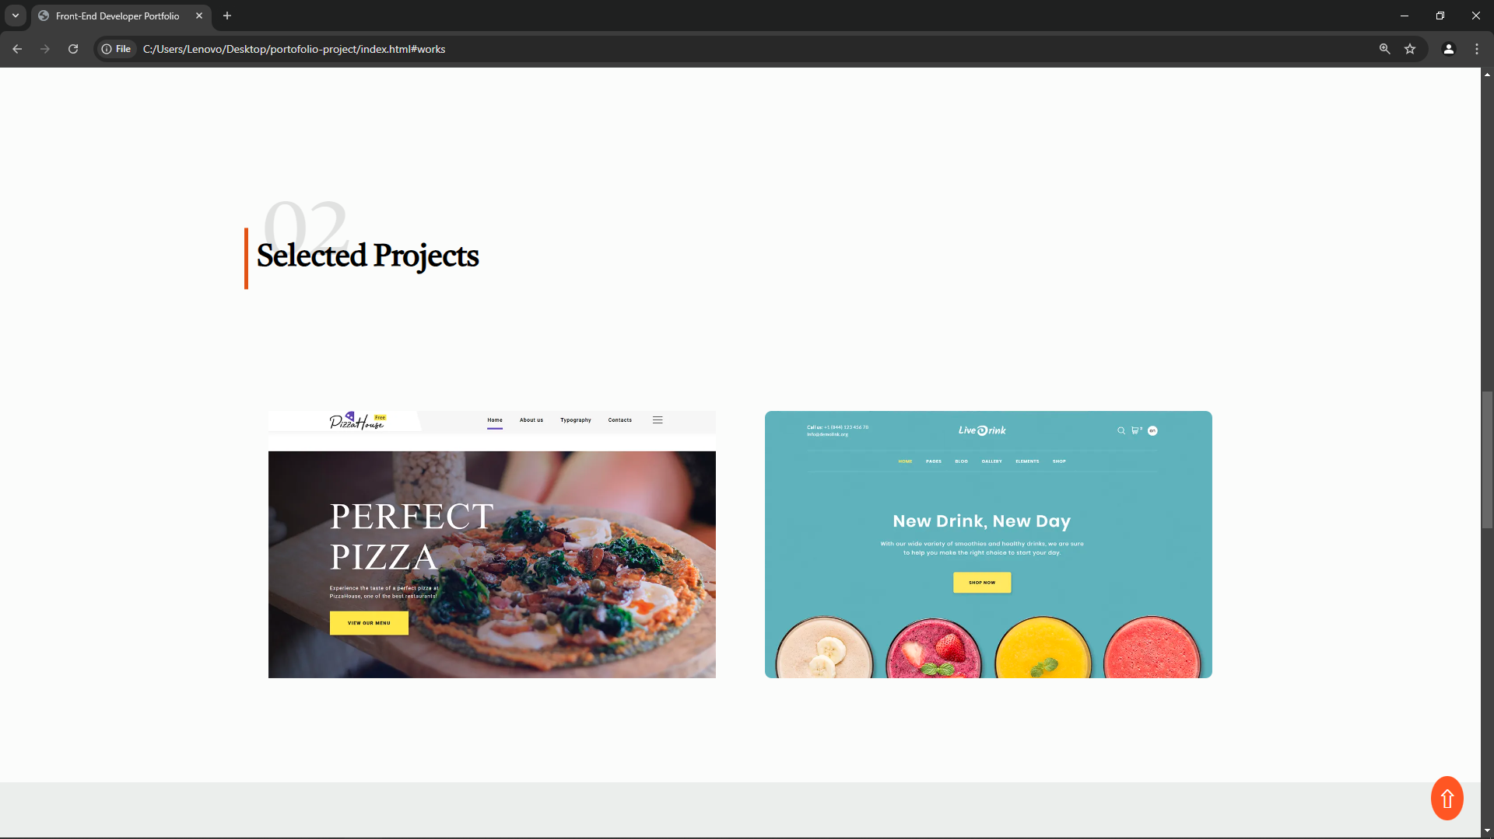
projects

Slide 7
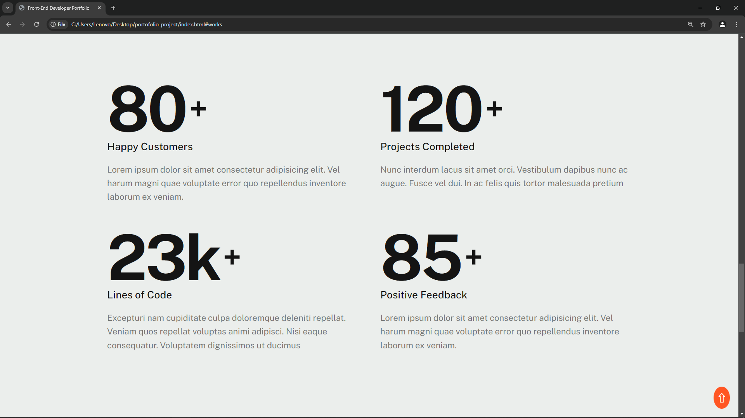
projects

Slide 8
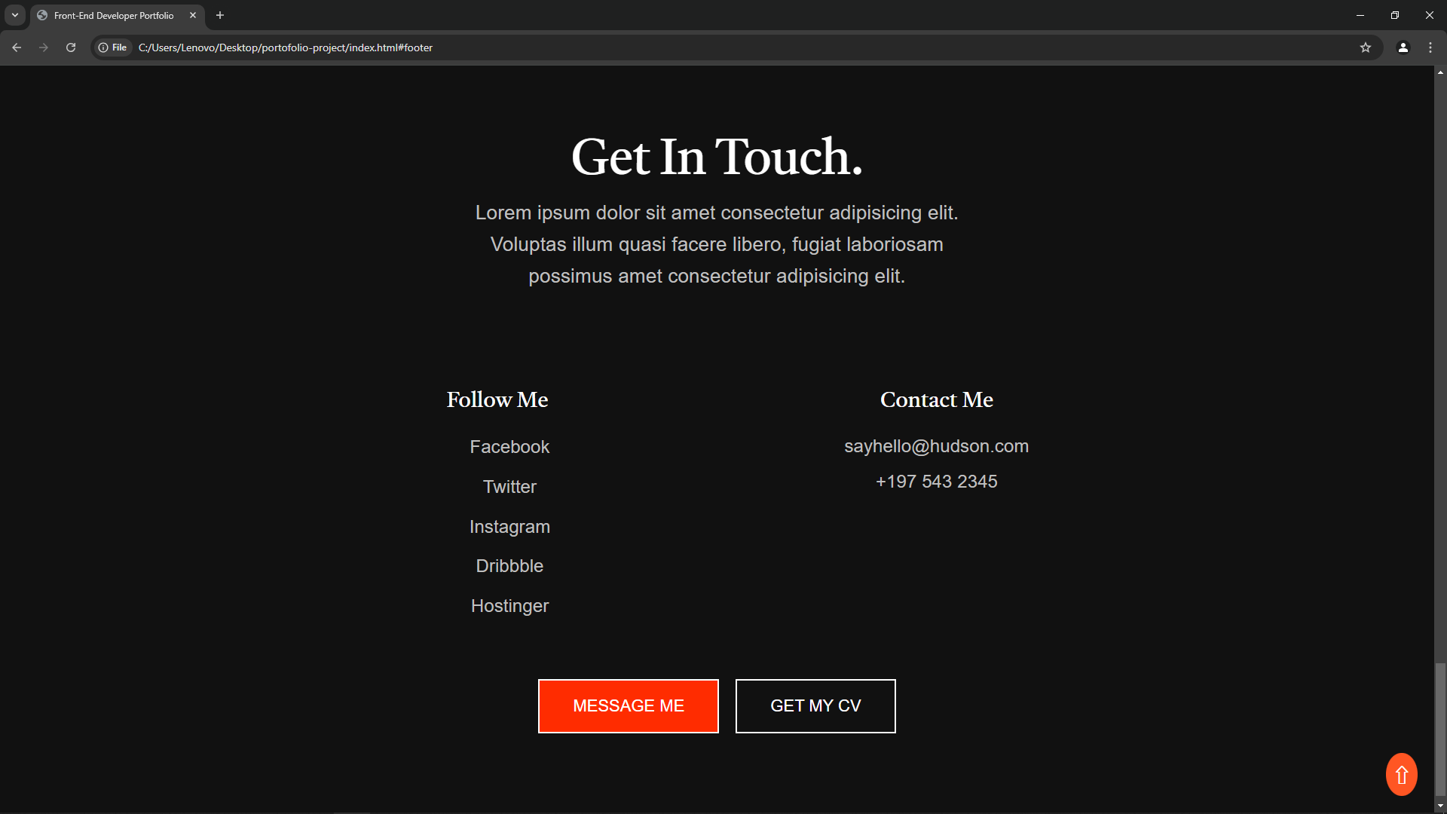
contact

Slide 9
Thank
you!

